Slide 1
Created by the students of SHS
Charlee Bourell
Christian Gill
Abby Mascal
Alex Mahan
Lucas Fraga
Katie Monaghan
And staff member, Kim Freeman

Slide 2
Planning and preparation
And Theatre Fest at a glance
Kim Freeman

Slide 3
Theatre Fest Objectives
I. To enrich the education of high school students:
By helping them realize through this experience that theatre is one way of fulfilling each individual's innate need and desire to create
By bringing diverse young persons together in an environment of creative and imaginative stimuli where theatre can be witnessed, experienced, ingested, talked about, and lived
By providing experiences in which each student can recognize and share common ambitions, goals, and interests with other students from diverse communities and programs
By allowing students to witness different types and styles of theatre processes and performance
By providing opportunities for students to showcase their creative efforts
II. To serve teachers, directors, and theatre sponsors:
By demonstrating specific educational theatre materials and techniques
By providing exposure to various program sizes and alternative approaches for theatre programs
By providing a showcase for accomplishments of student groups
By developing a forum and network for the exchange and sharing of ideas to build and expand theatre programs

Slide 4
Schedule and things to do:
Planning started January of 2022
5 meetings (2 at U of I)
Opening Ceremonies
College Auditions- Over 40 different Colleges from 5 different states were watching auditions and interviews for scholarships.
Workshops- Over 120 different workshops from acting to tech, costumes, makeup
Shows- 13 school-brought shows: “Spamalot”, “Matilda”, “As You Like It”, “Puffs”, “Bad Seed”, “Alice in Wonderland”, “Theory of Relativity”, “Addams Family”, “Radium Girls”, The Bomb-itty of Errors”, “Sorry Wrong Number”, “Carrie”, and “War of the Worlds”.
Allstate Production- 5 shows in 3 days!

Slide 5
Opening Ceremony and Shrek
By Charlee Bourell

Slide 6
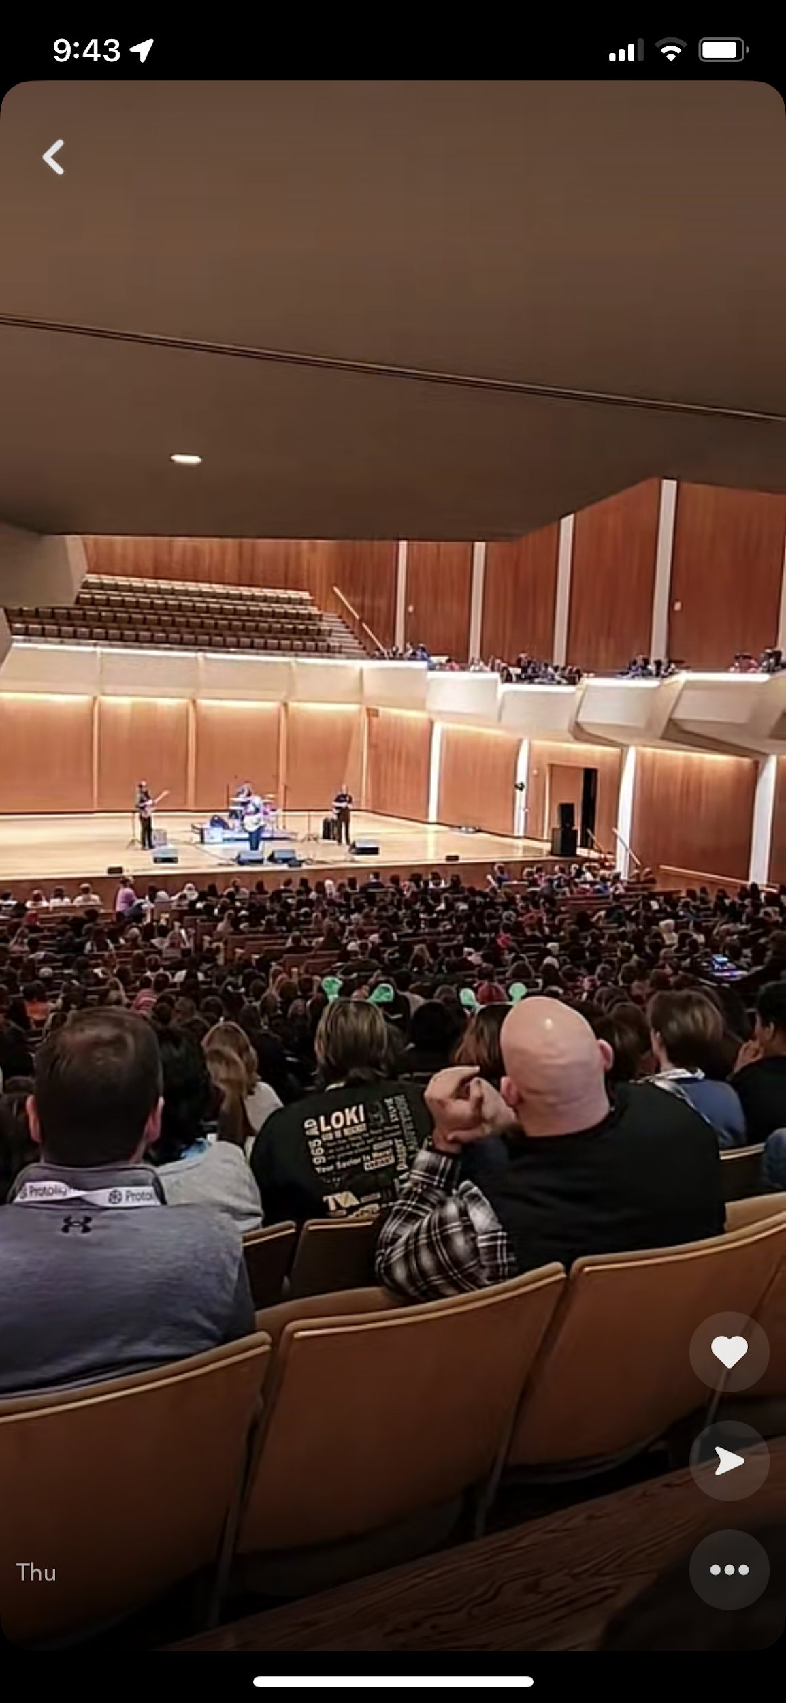
Opening Ceremony
Executive Director spoke to us about diving into Fest and making the most of it. Speakers were nice and sincere
Teachers who helped plan festival walked across the stage. It was cool to have a SHS teacher to cheer for.
Leah Marlene performed as a local artist.
Leah was entertaining
The people who spoke were passionate about what they did.
Some of their speeches resonated because of their sincerity
It was a great start to theater fest. It got energies up and made us realize how many kids were there so eager about theatre.

Slide 7
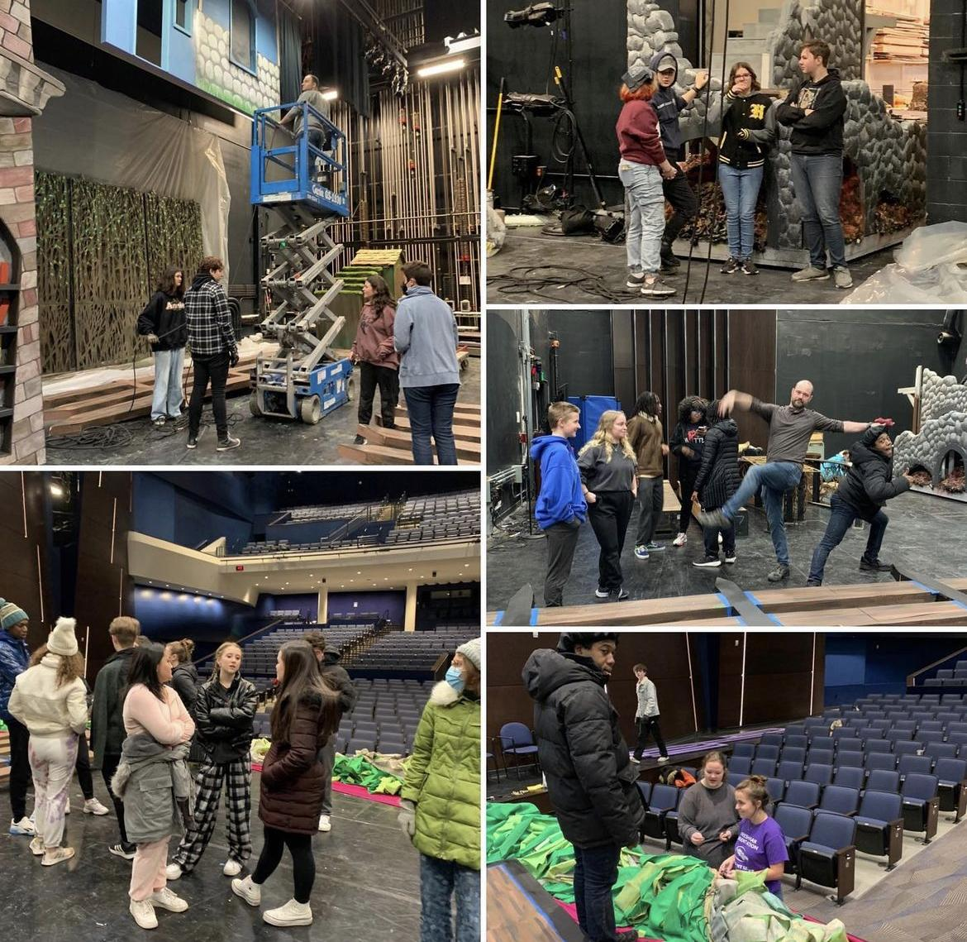
Shrek
Amazing play overall
Set design was fantastic
Actors were so good
Everyone on stage was so talented
Audience was great
I really enjoyed everything about it
The musical was funny and sweet
I wanted to see it three more times
It was cool that we had a Streator student working backstage

Slide 8
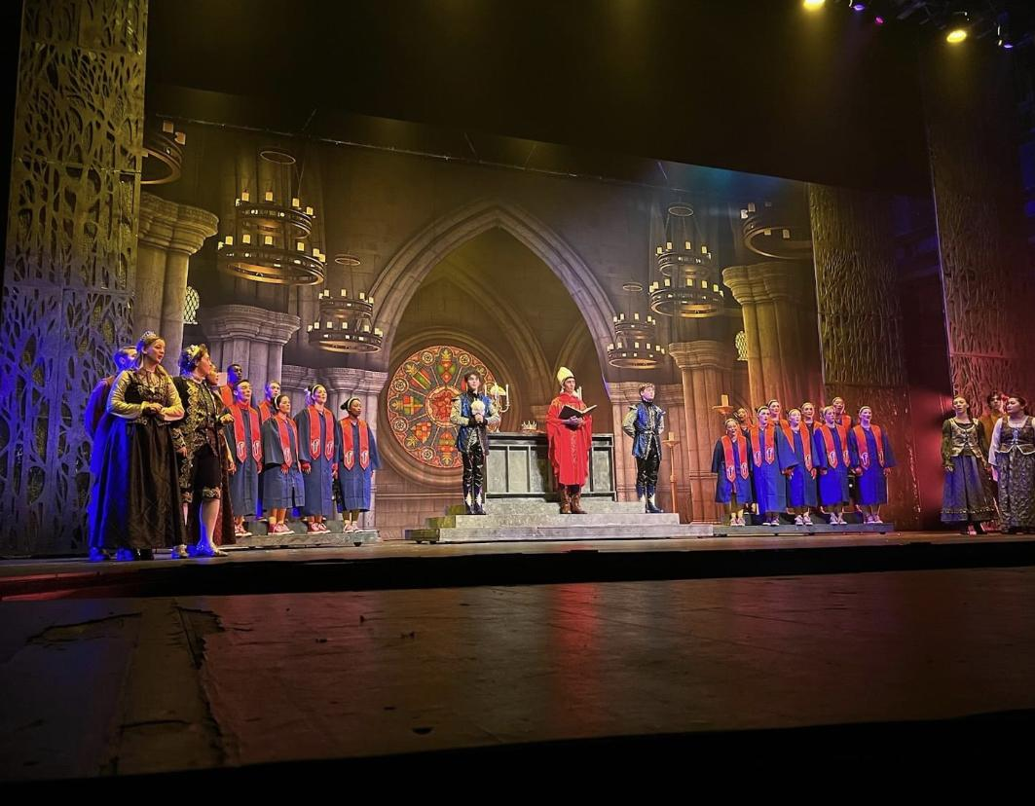
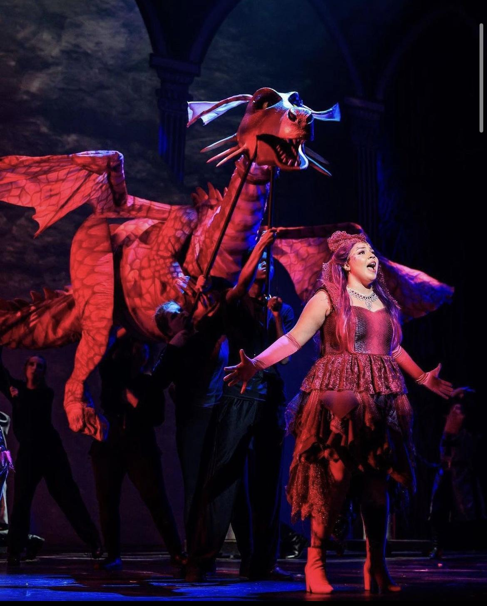
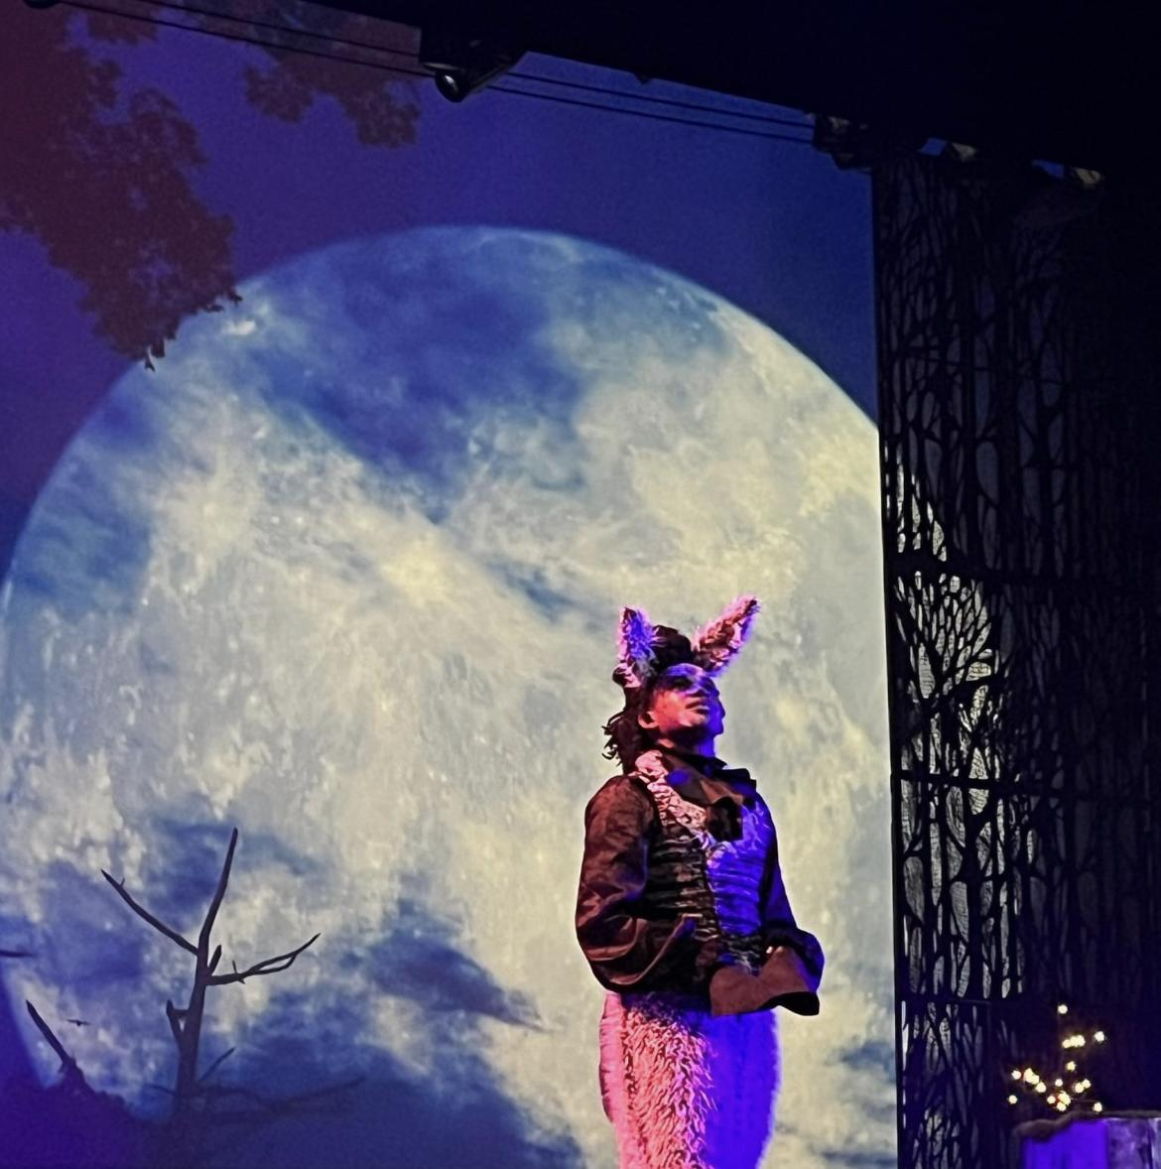

Slide 9
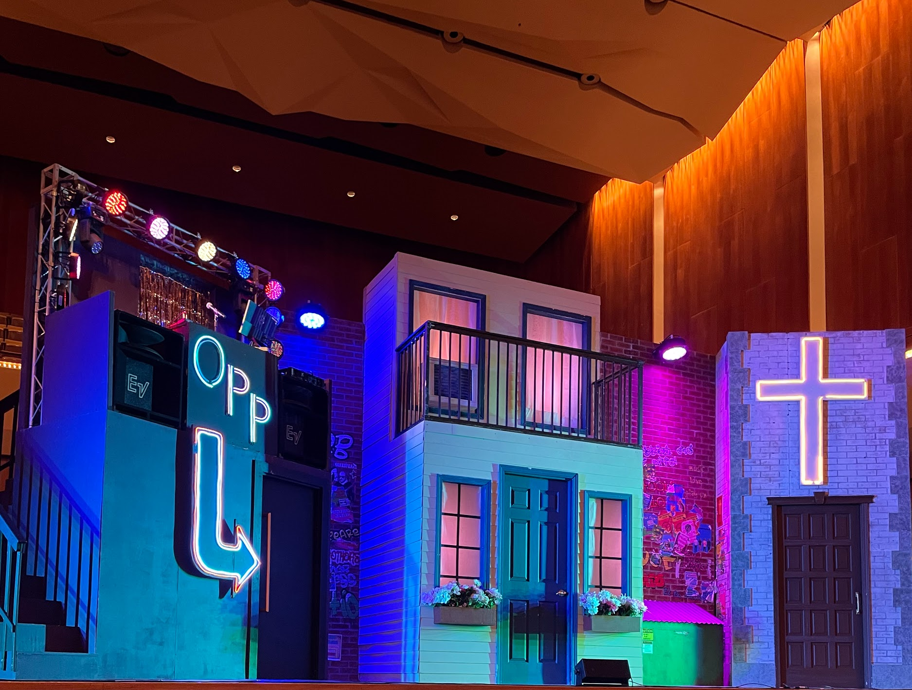
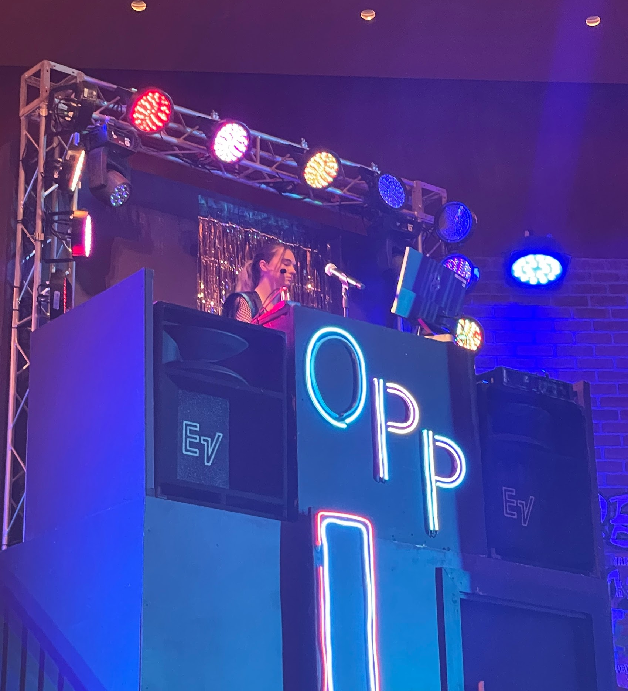
Saturday Shows
By Lucas Fraga

Slide 10
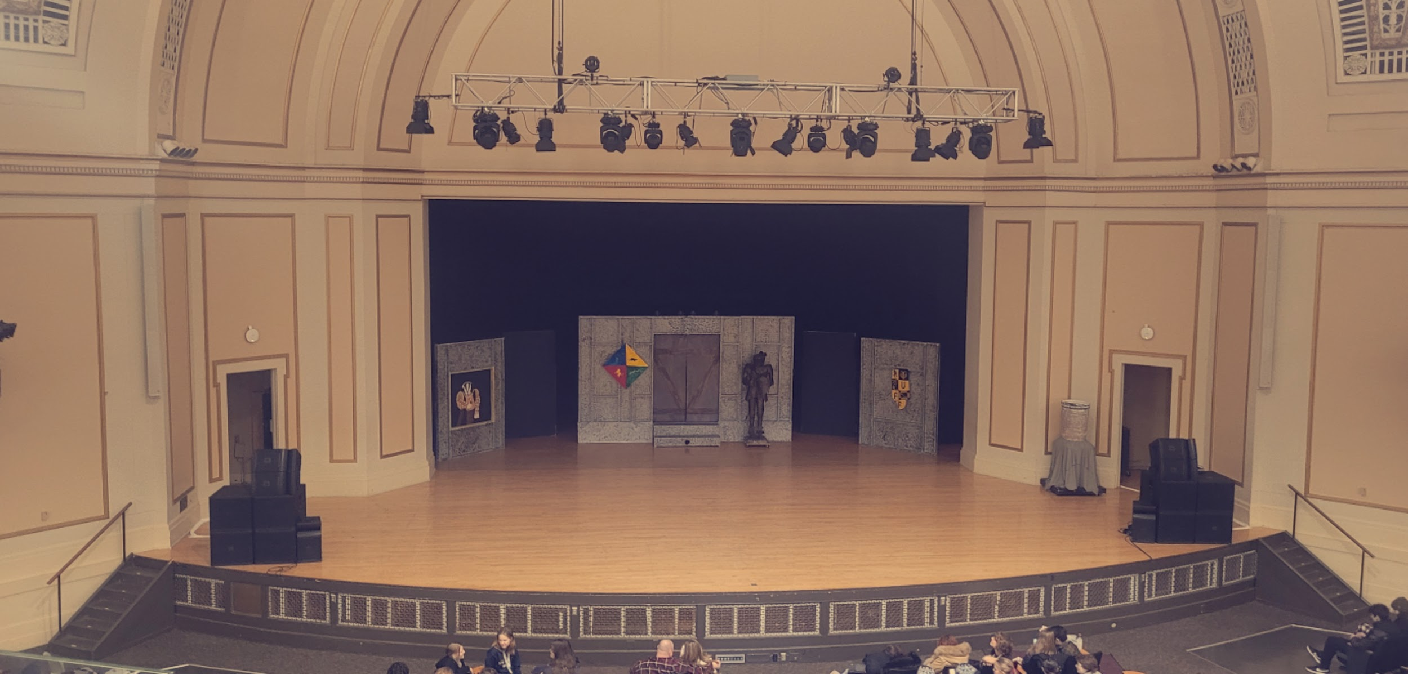
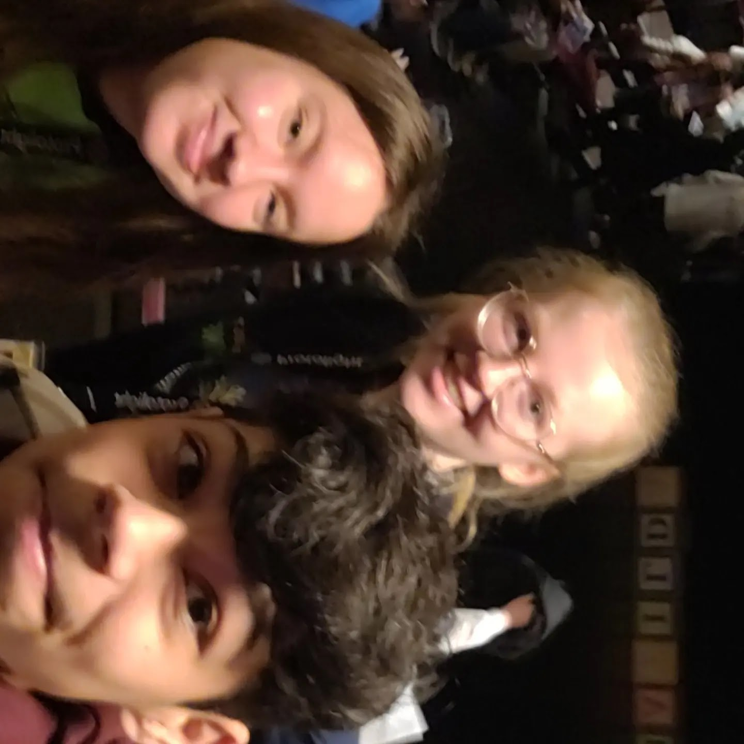
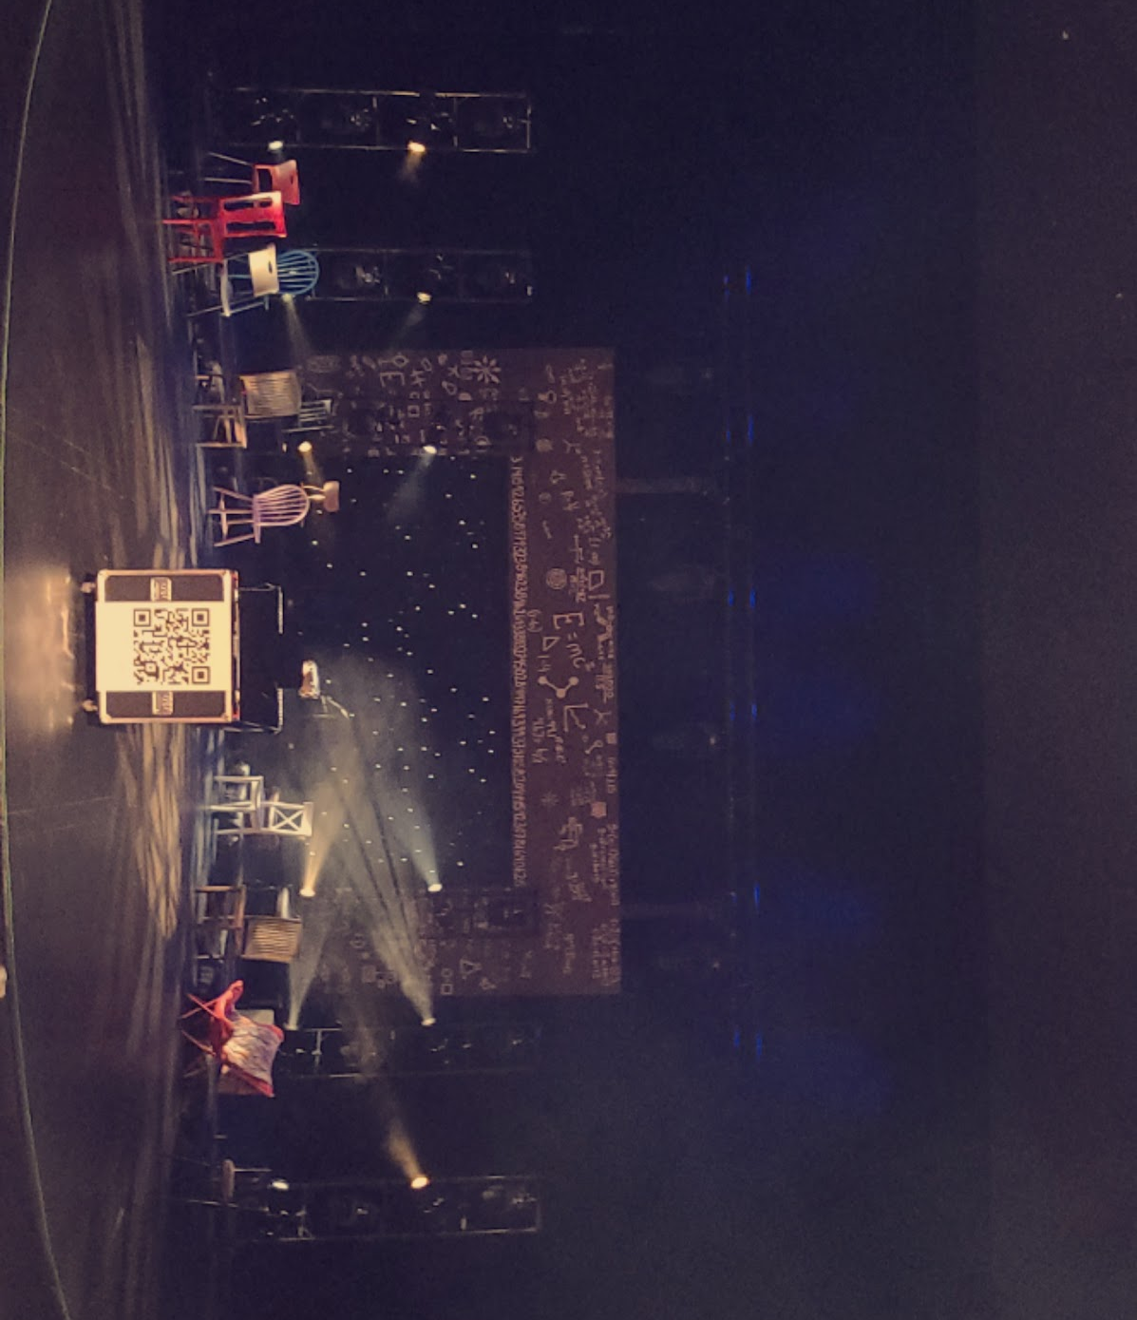
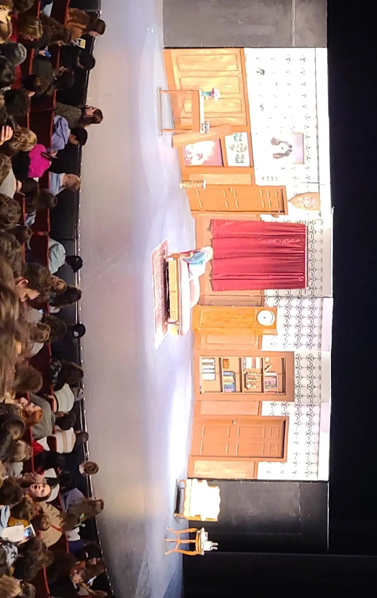
The two shows that I went to see on Saturday was Matilda and Puffs
I liked both of these shows a lot. Not only because I enjoyed watching them but because of the motivation I got from watching and learning from them. It motivated me to do better in theater and take it alot more seriously. It also showed me what our theater productions could be like if we all put in more effort and tried our hardest all of the time.
I definitely feel like I learned more by watching the musicals than the plays but I really enjoyed the plays equally as much because it motivated be to do better acting wise.
Overall, I really enjoyed the experience of theater fest. My favorite part was being able to do all of this with people who enjoy theater as much as I do. I would definitely go again if I had the opportunity to.

Slide 11
Workshops and Friday Fun
By Abby Mascal

Slide 12
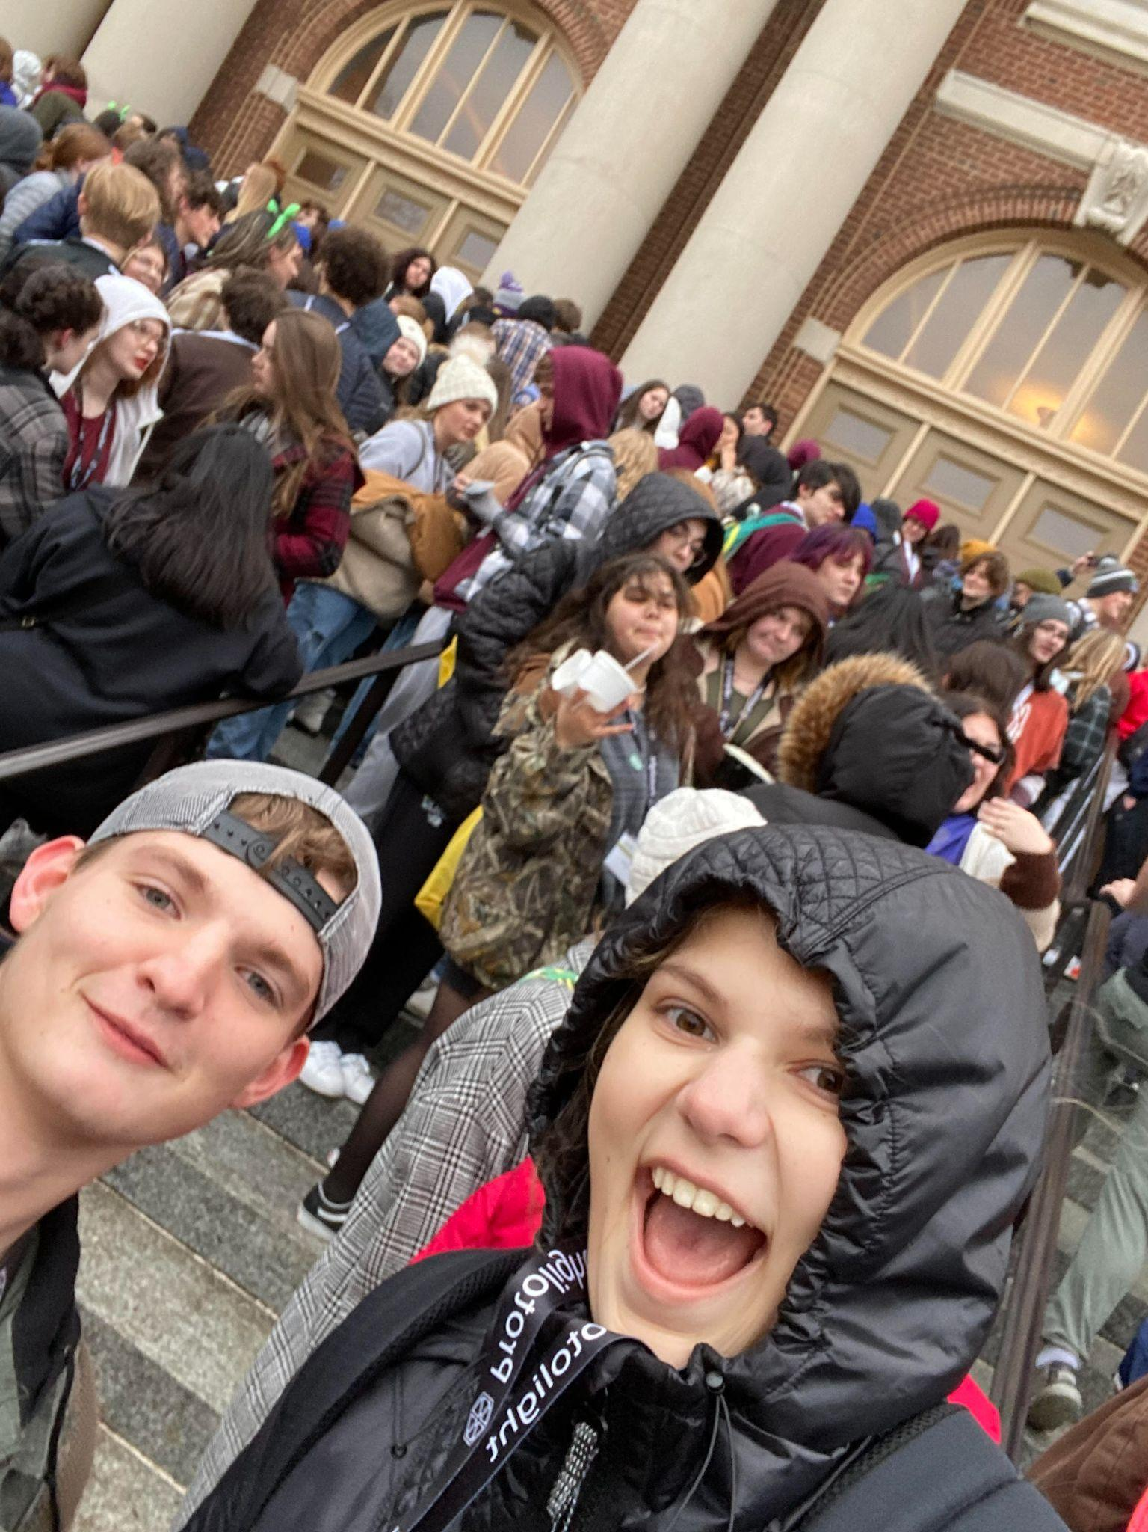
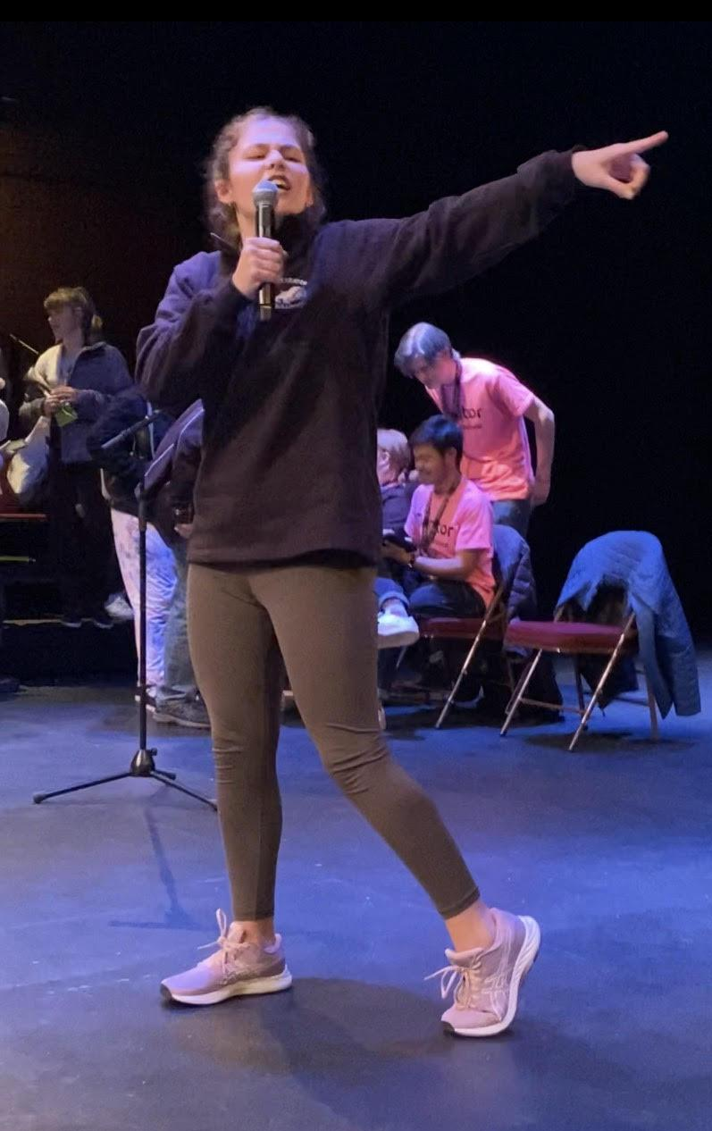
Workshops
&
Fun Experiences

Slide 13
Workshops
Workshops for all branches of theatre
Very hands-on and interactive
Meet new people
Use your time wisely
Abby was able to go 7 workshops and see 2 shows

Slide 14
Fun Experiences
Tons of great shows
FOR FREE
Karaoke
Raffles
Location: U of I
Safe Campus
Less than 10 minute walks between theatre fest building
Great options for meals
10 Minute drive from Hotel

Slide 15
More workshops and Experience
By Katie Monaghan

Slide 16
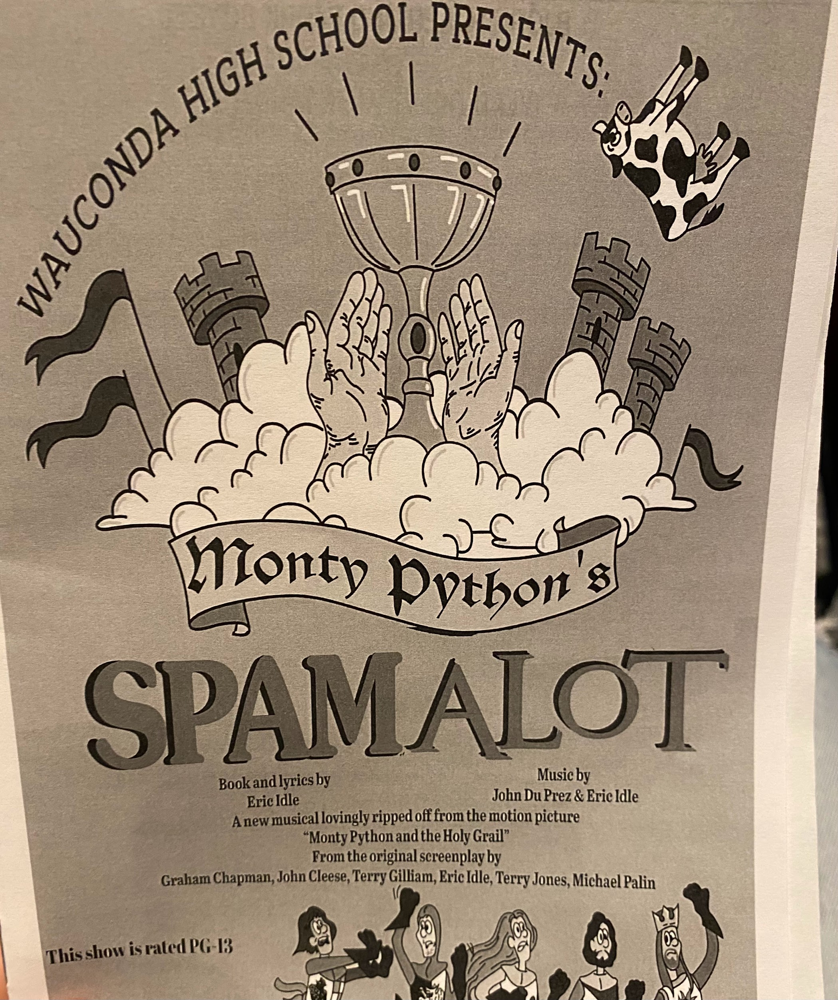
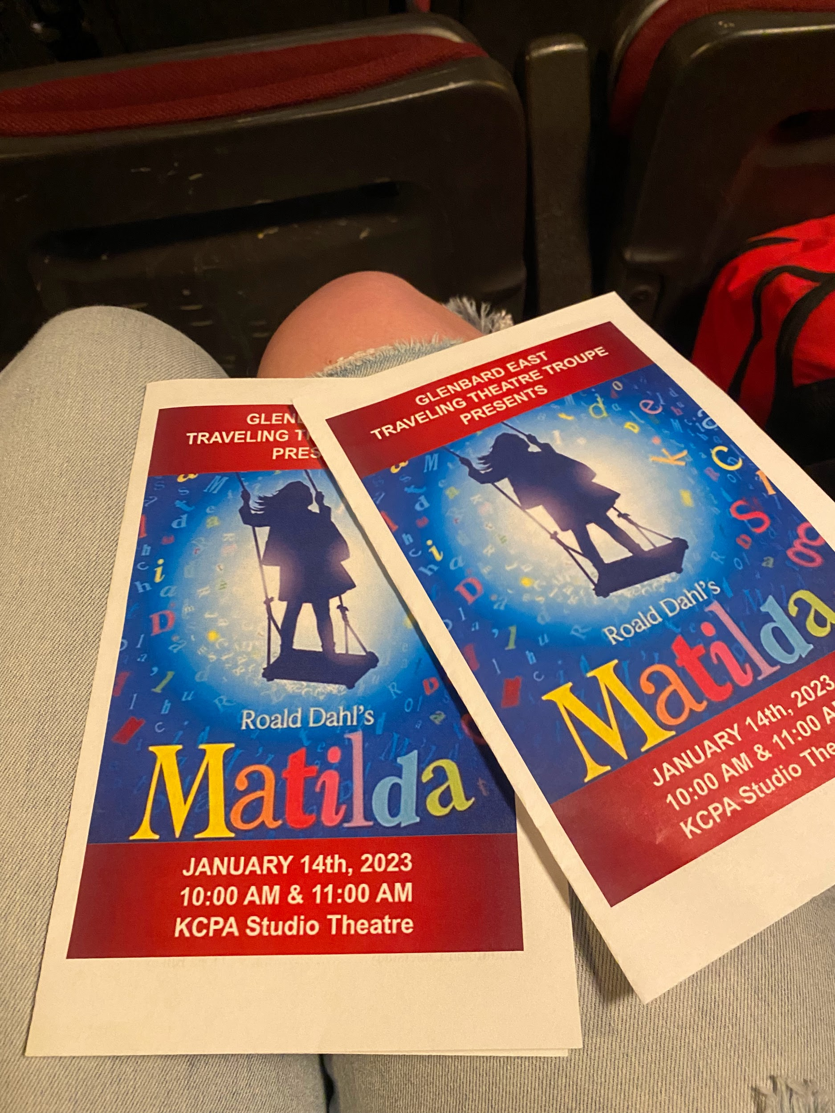
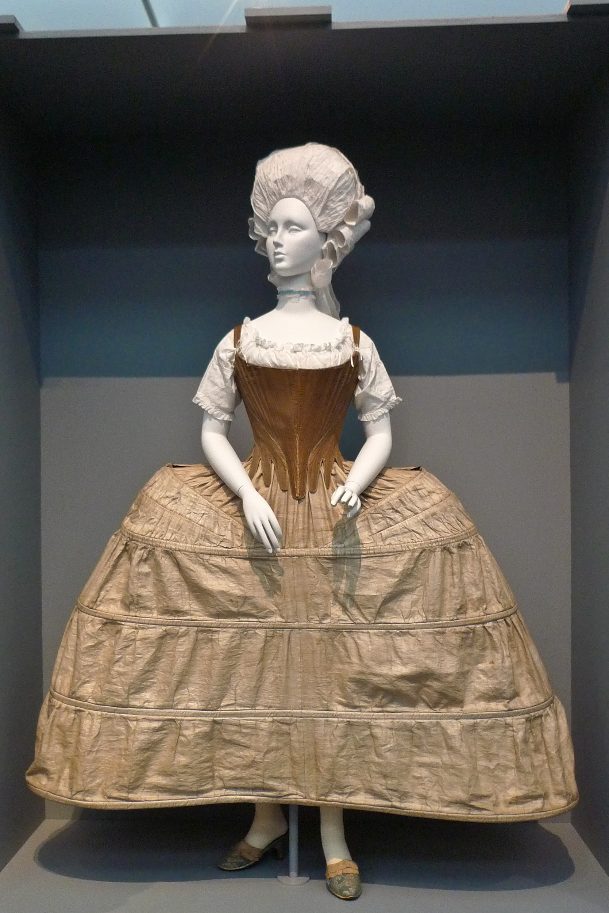
Workshops I attended:
How to act drunk/on drugs
During this workshop we had to lay on the ground and go into a deep relaxed state where we are awake but unaware of our surroundings, than we were told to stand up but found it difficult because we were so tired and that was how to act drunk.
Underwear is FUN to wear!
We learned about the hoops skirts women would wear under their dresses and how it evolved over-time.
Workshops
Shows I attended:
Workshops I wanted to attend:
IMPROV 101
Ballroom Dancing

Slide 17
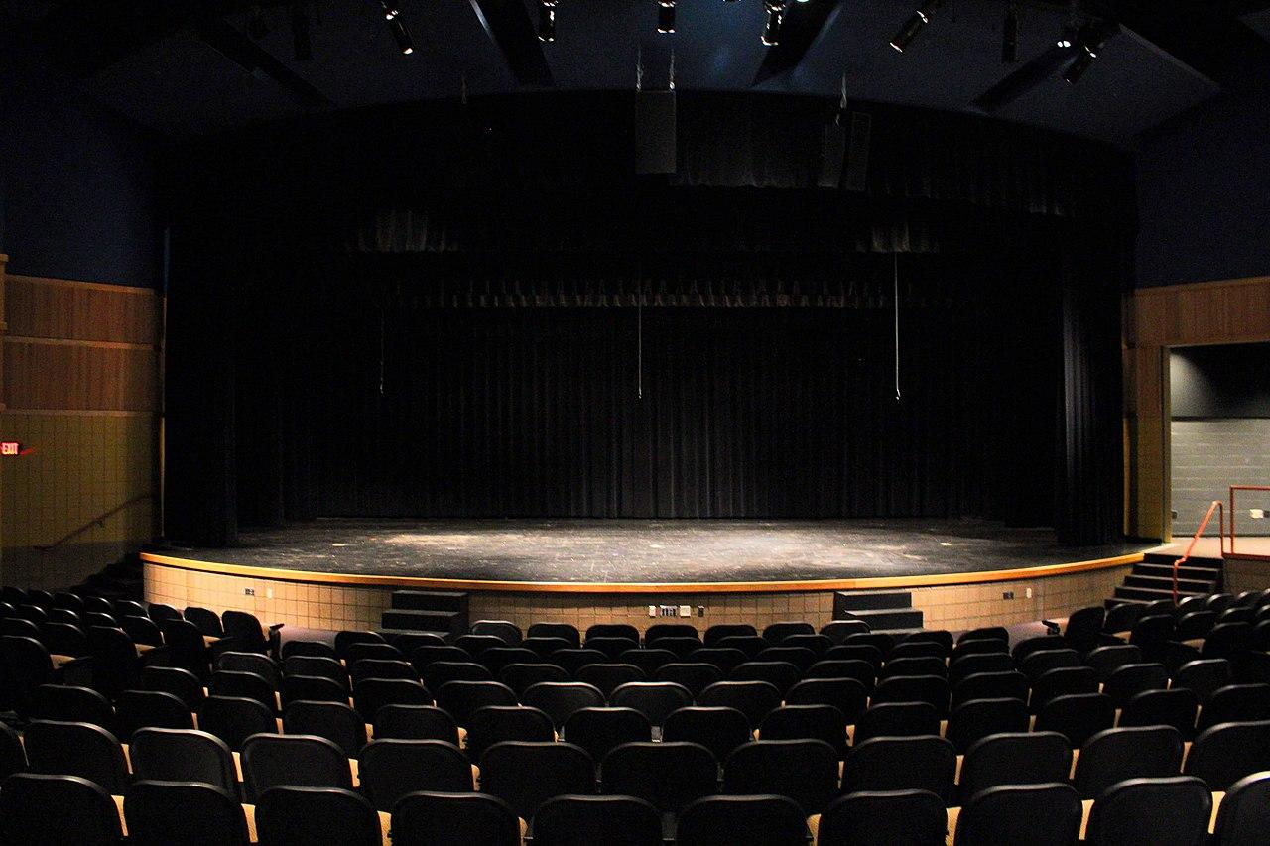
Experience
Positive
The Theatre Fest Trip was an amazing learning opportunity, from getting to explore the campus to doing the workshops; I felt my time there was beneficial.
I enjoyed getting to see many different productions being performed by high schools chosen for All-State. Their performances were unbelievable! It was outstanding to watch and to have that experience.

Slide 18
Networking
Christian Gill

Slide 19
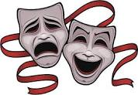
Networking at IHSTF
Theatre Fest was TONS of fun!
I met a lot really cool kids and some pretty cool people that had a lot to teach me.
I also got a look at some of the companies that do lighting professionally.
I even got a job offer from a company called Grand Stage, which I am currently pursuing.
So many workshops. Really made me want to do something with theatre as a career.

Slide 20
Saturday Shows
Alex Mahan

Slide 21
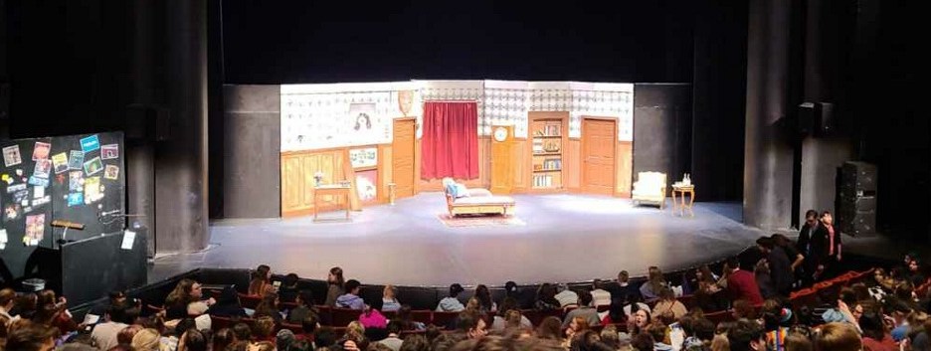
Saturday Shows
The Play That Goes Wrong- We did this play at Streator High School and it was a lot of fun. Going to watch another school put on this performance was amazing because we got to see how they acted and see how they perform the show. I think if we hadn’t done this show here it would have been funnier but knowing what happens in the show it took some fun out of it. But it was still a lot of fun and it was overall a good show!
Theory of Relativity- This was a hard show to understand in the beginning but it all came together in the end. After watching this I think it is one of my favorite musicals. All of the songs are fun and different from other musicals. It is basically what people can go through during their everyday lives. I enjoyed this musical a lot! I would love to watch it again or maybe even try and put it on one day. It is one of my favorite musicals now!

Slide 22
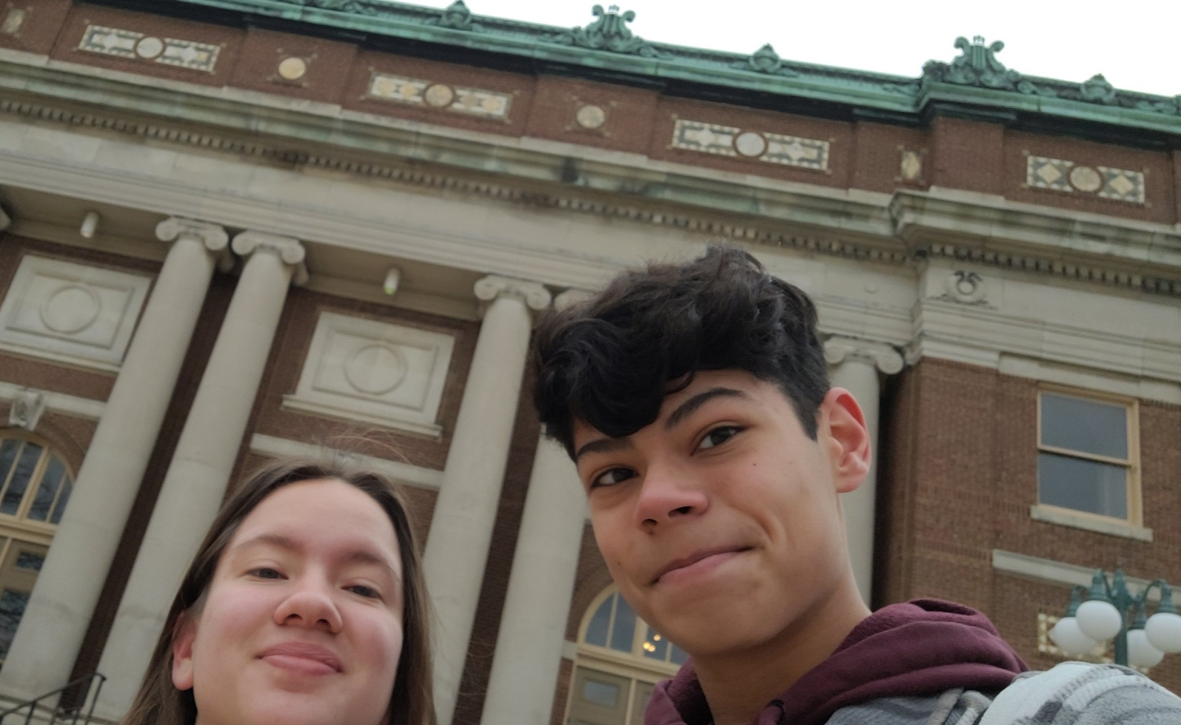
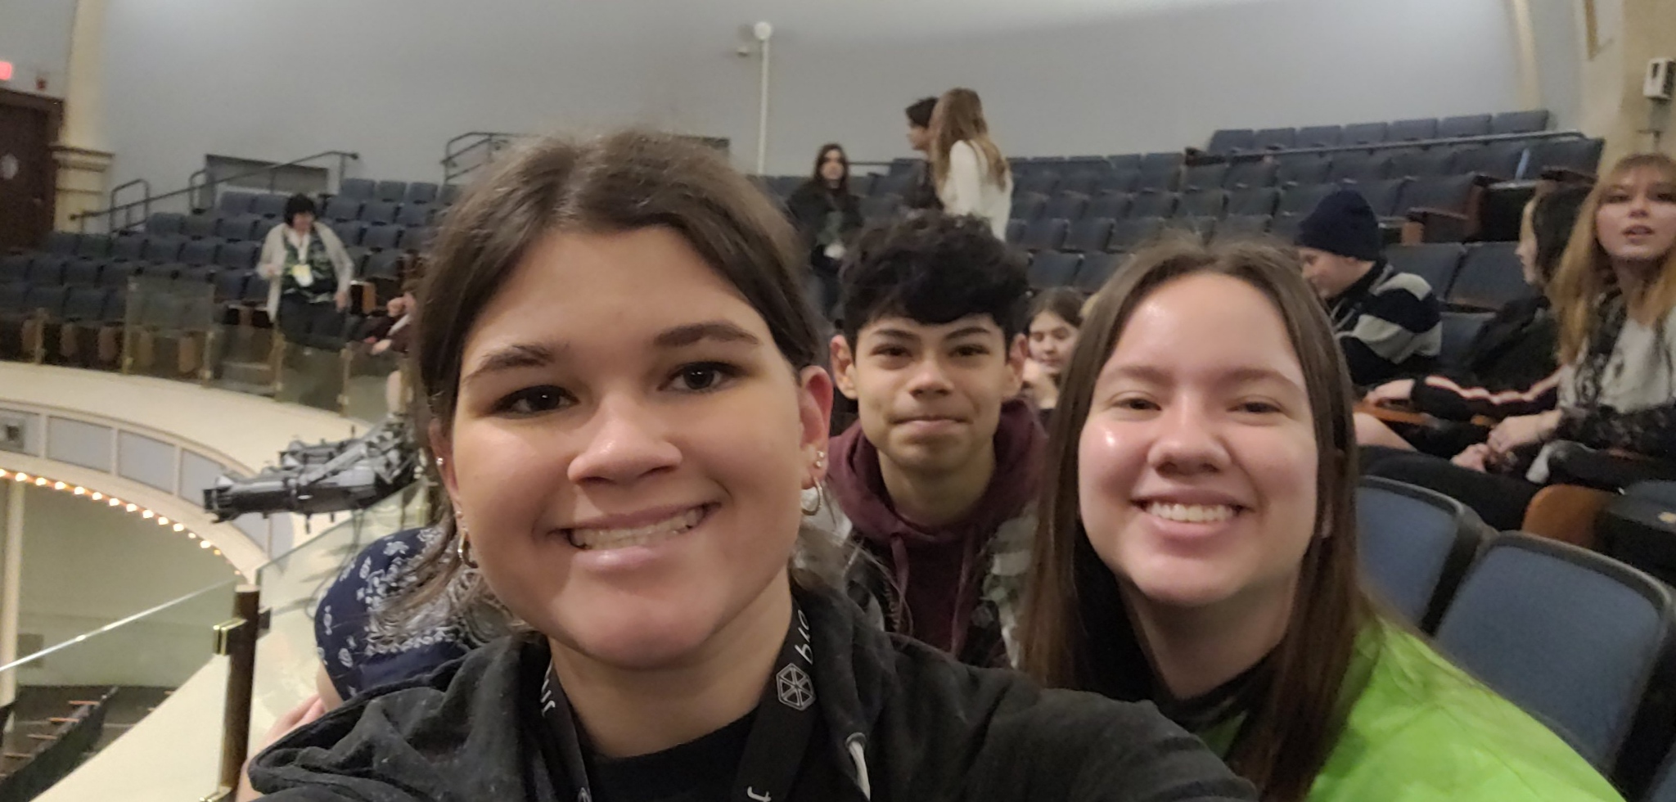
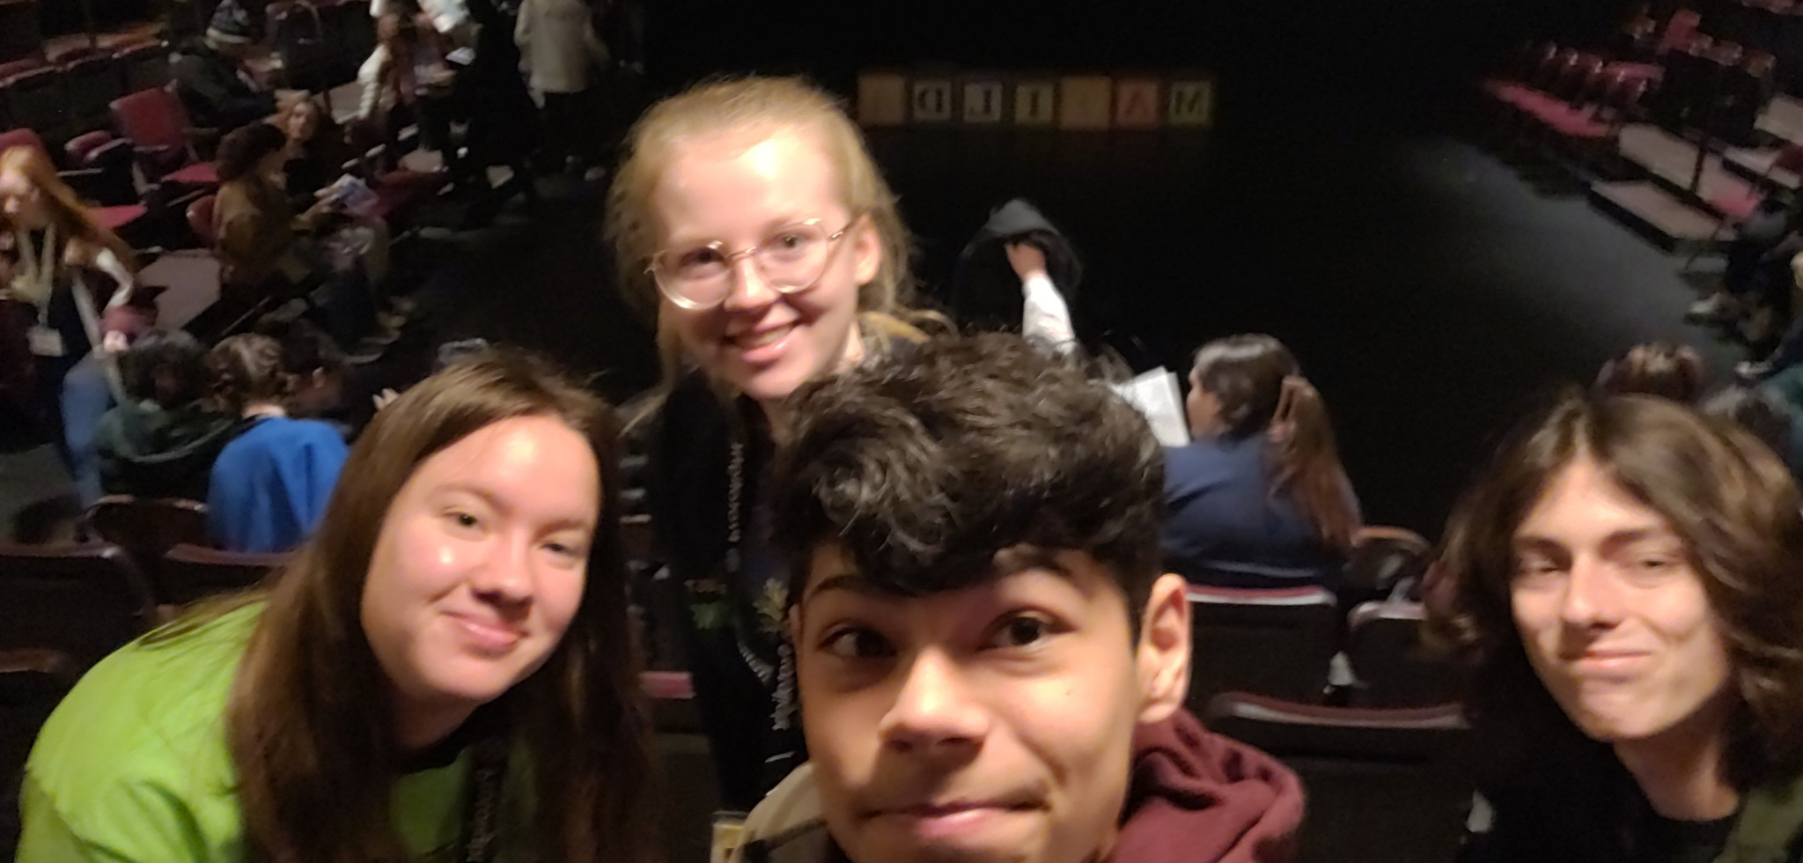
My experience
Going to Theatre Fest was a amazing! I enjoyed going to the shows I went to because I feel like I learned a lot more about acting by watching other actors, it also pushes me to work harder so that one day we can get a show to All-State. I loved this trip because i got to see other theater kids there and see them enjoy being there as much as I did, as well as I got to see colleges that give us many opportunities when wanting to go into acting as a major or just wanting to do shows while in another major . We got to go and do many fun activities like karaoke that night was fun we got to sing and the theater kids were very supportive after you finished singing whether you were good or bad at it. We got to have one on one time with Freeman at times and be able to talk to her about our day or just how we felt in general. If I was given the opportunity to go to Theatre Fest again I so would go it was so much fun and I feel like I’ve learned a lot from going as well as met so many nice people from going on this trip. I loved it a lot it was one of my favorite school trips and it will definitely always be!

Slide 23
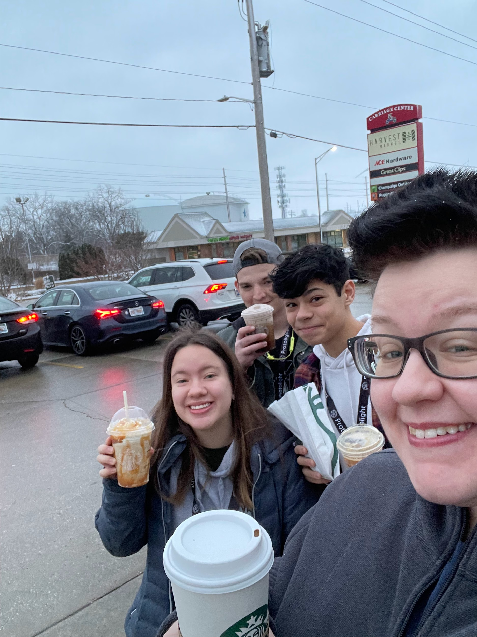
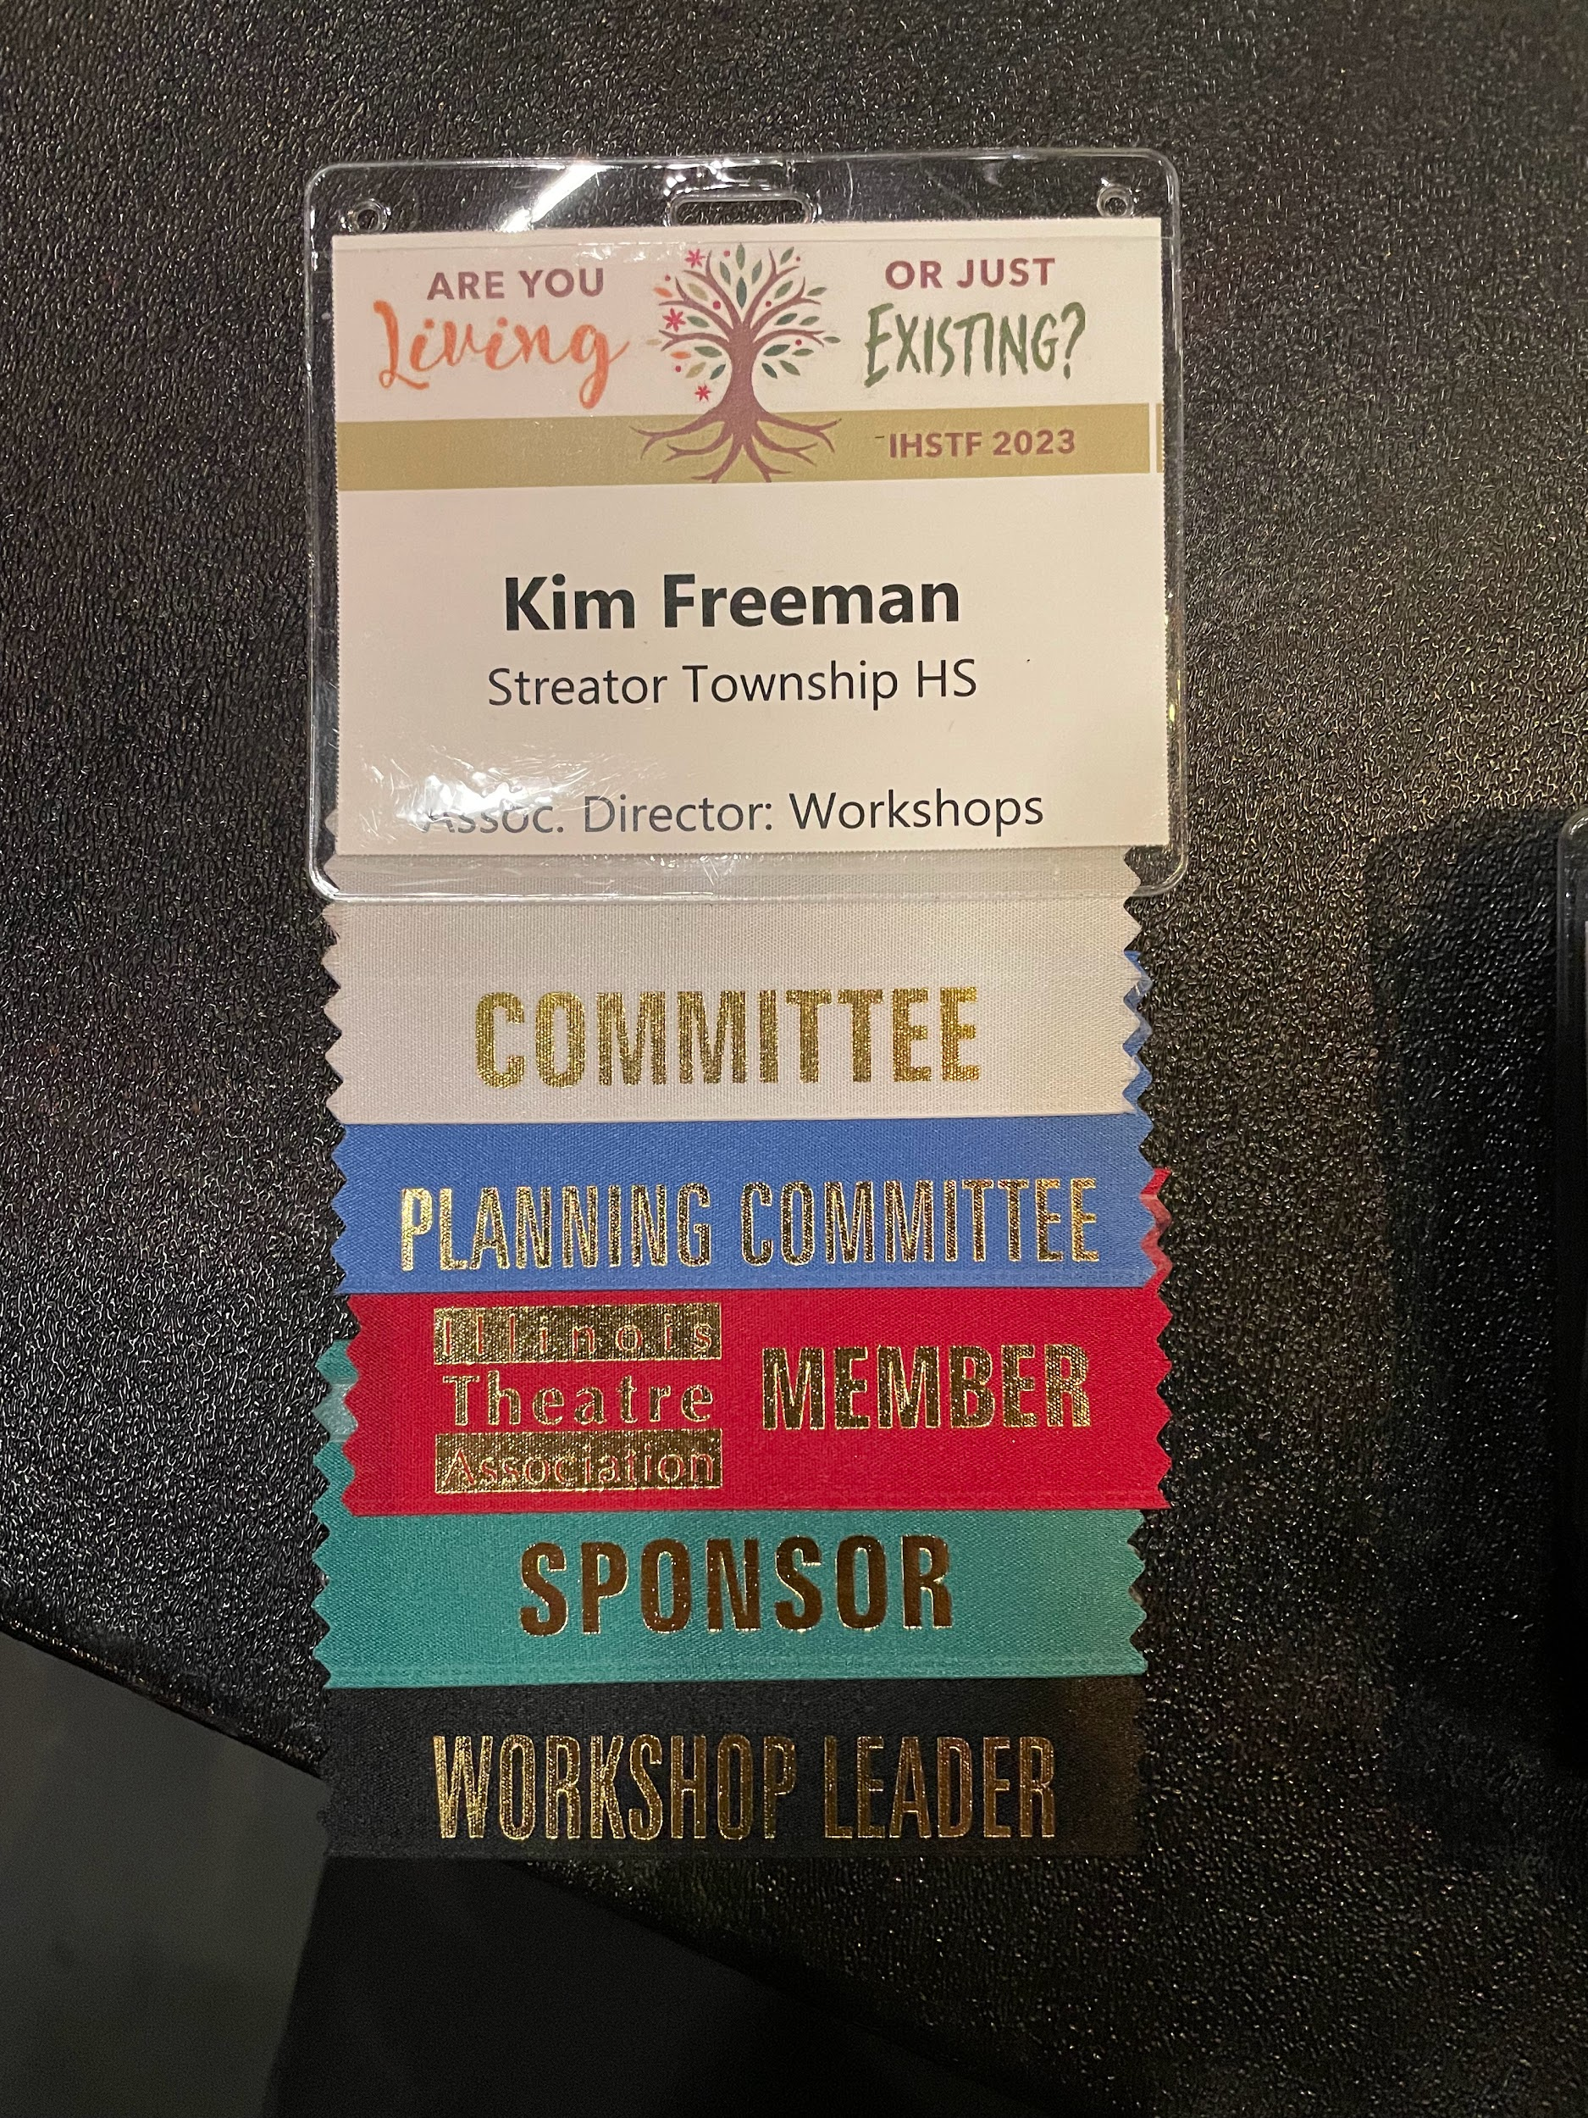
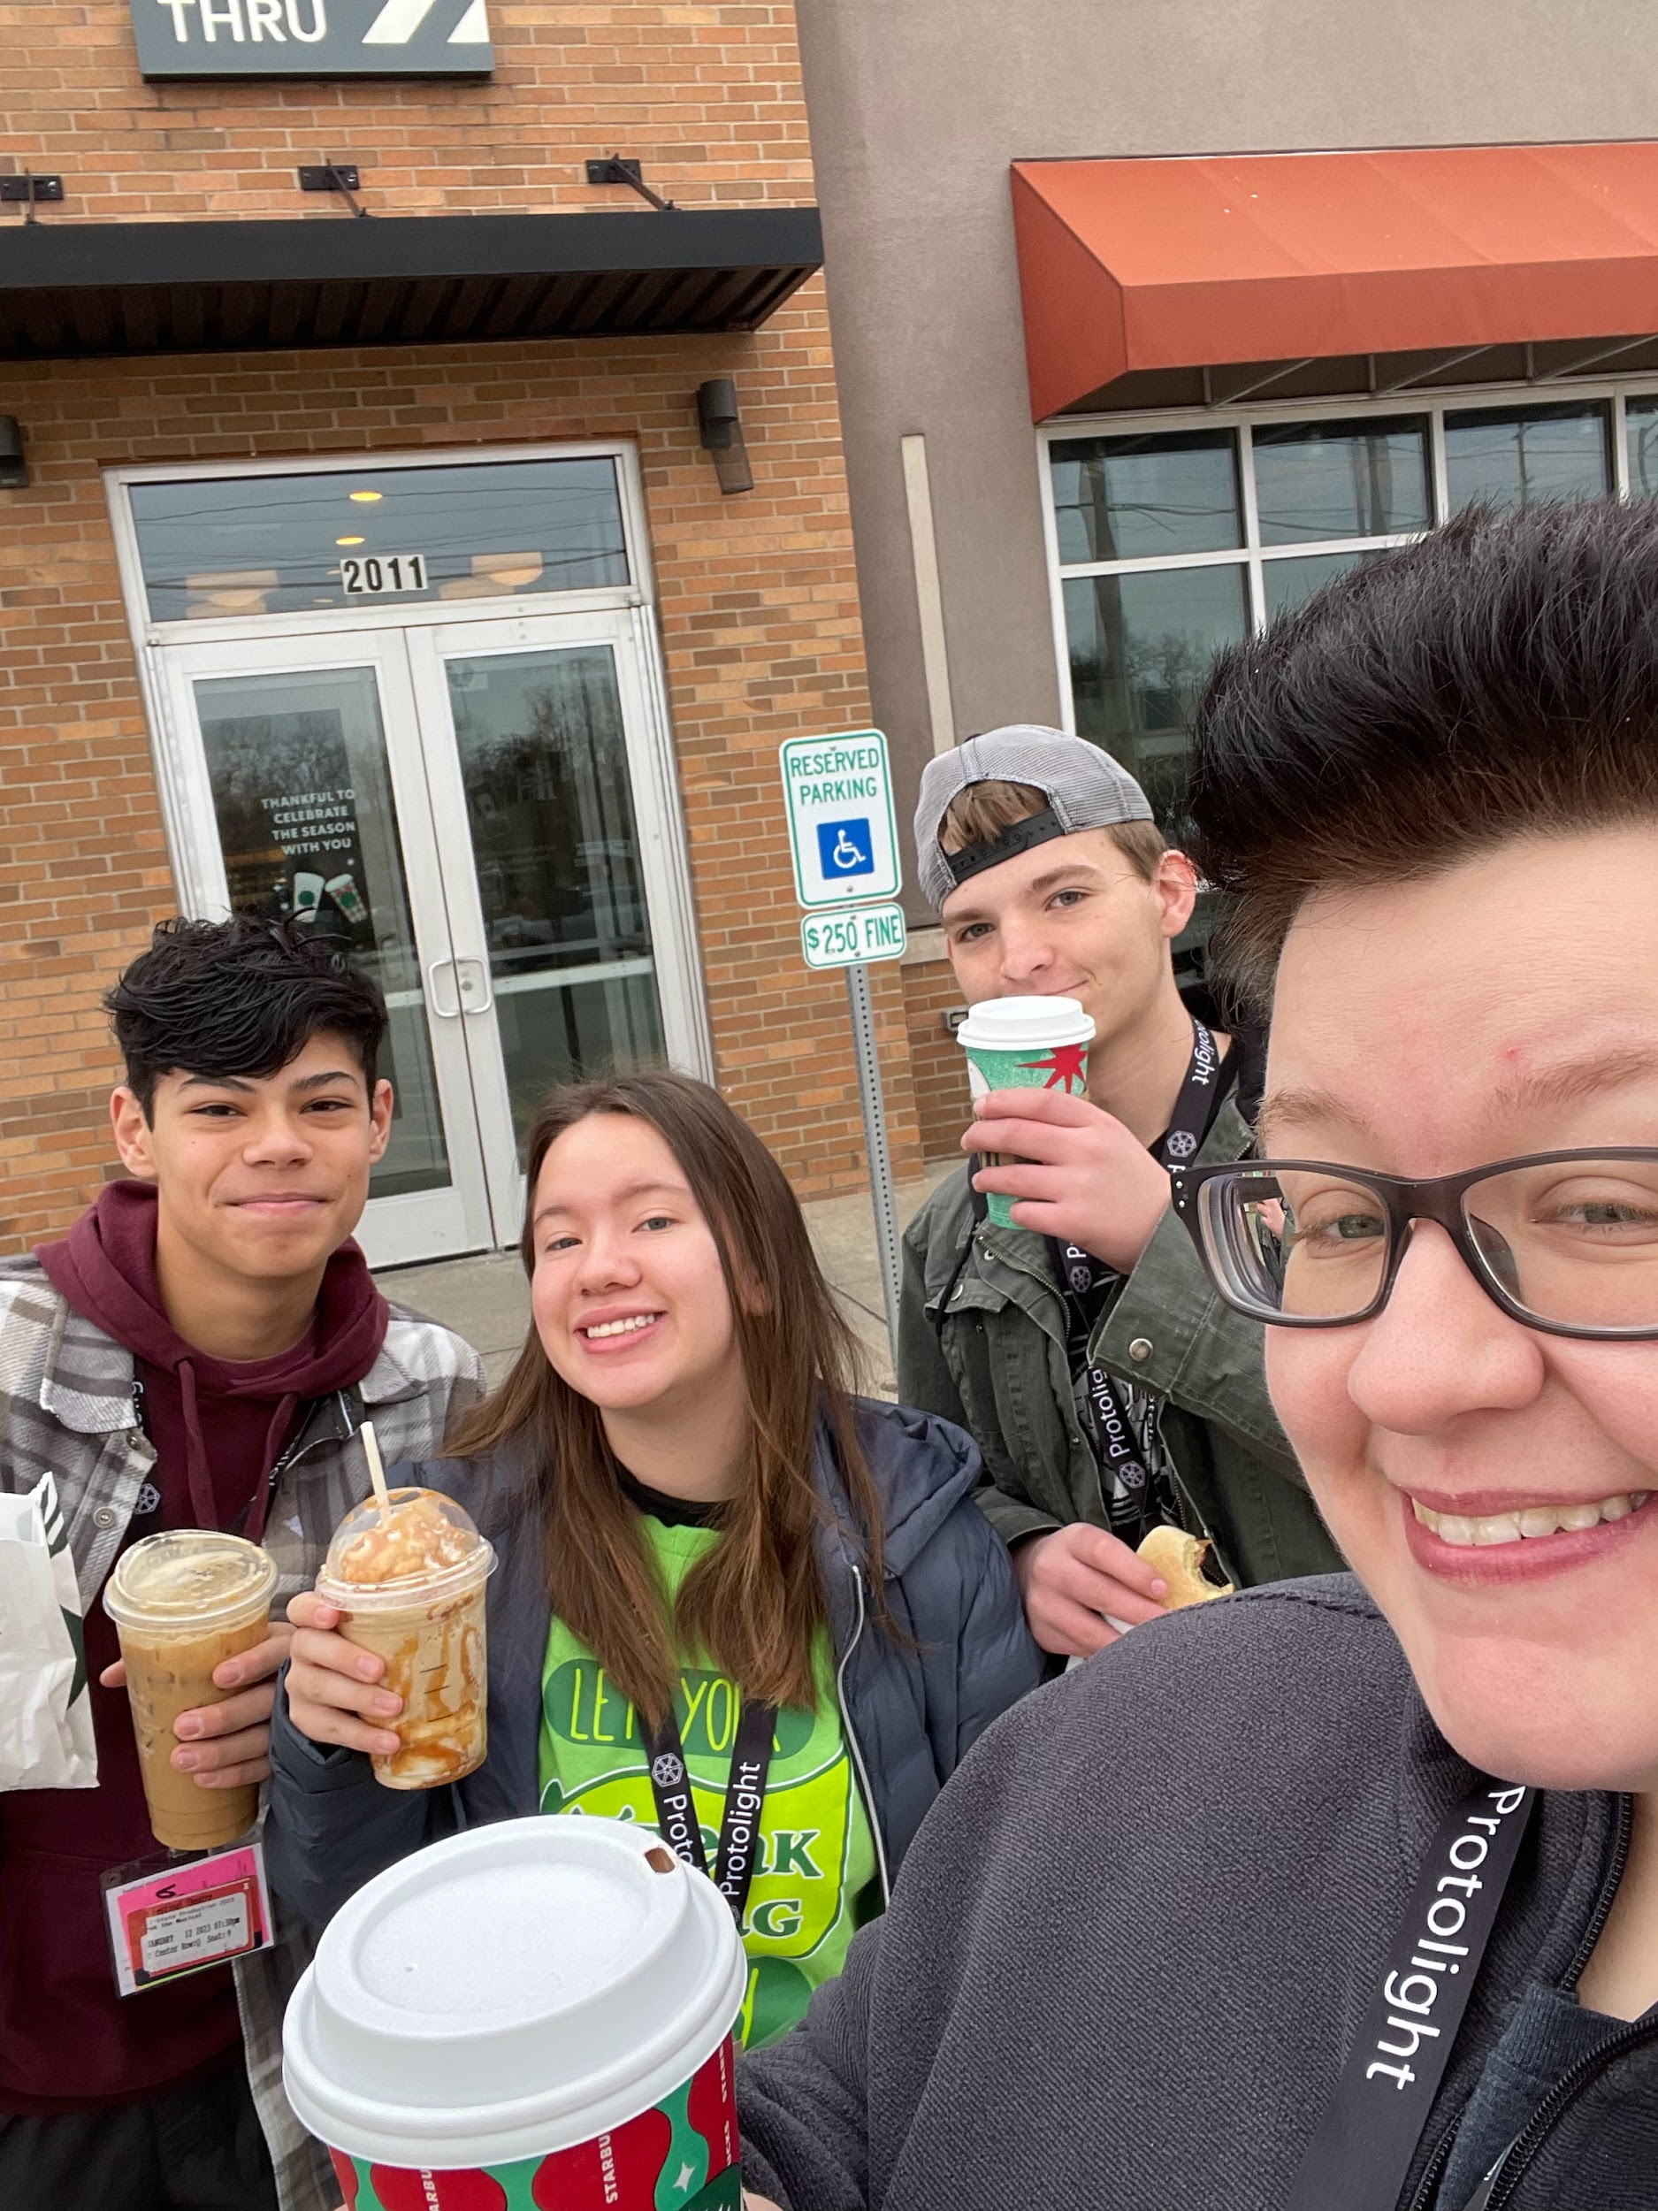
Freeman’s Coffee Crew

Slide 24
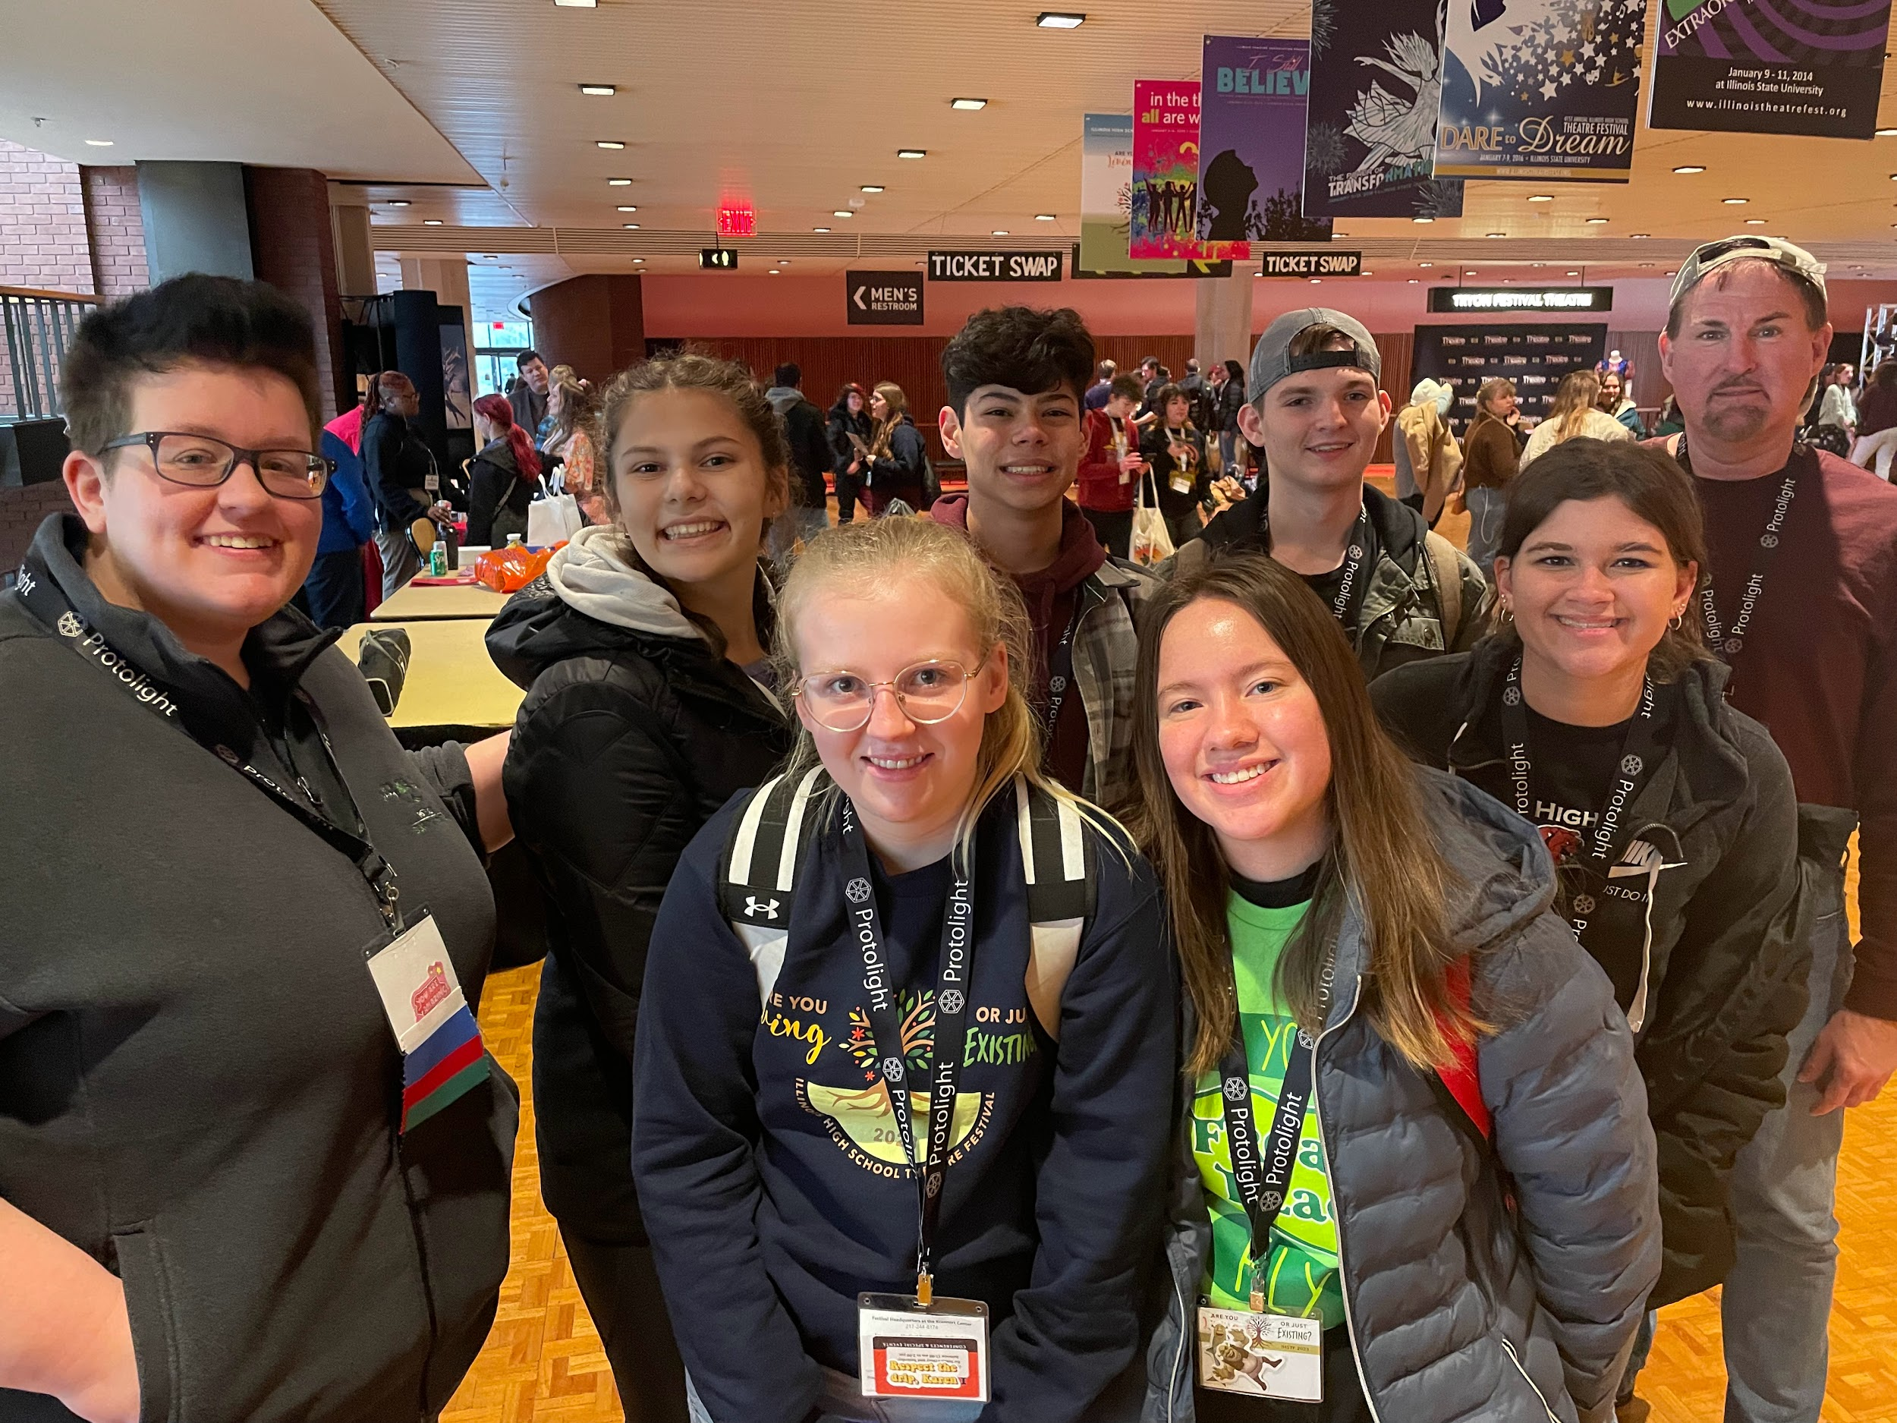
Thank You!
Thank you for allowing us to attend the conference at U of I. Thank you for supporting the Theatre Department and supporting us as we grow.

Slide 25
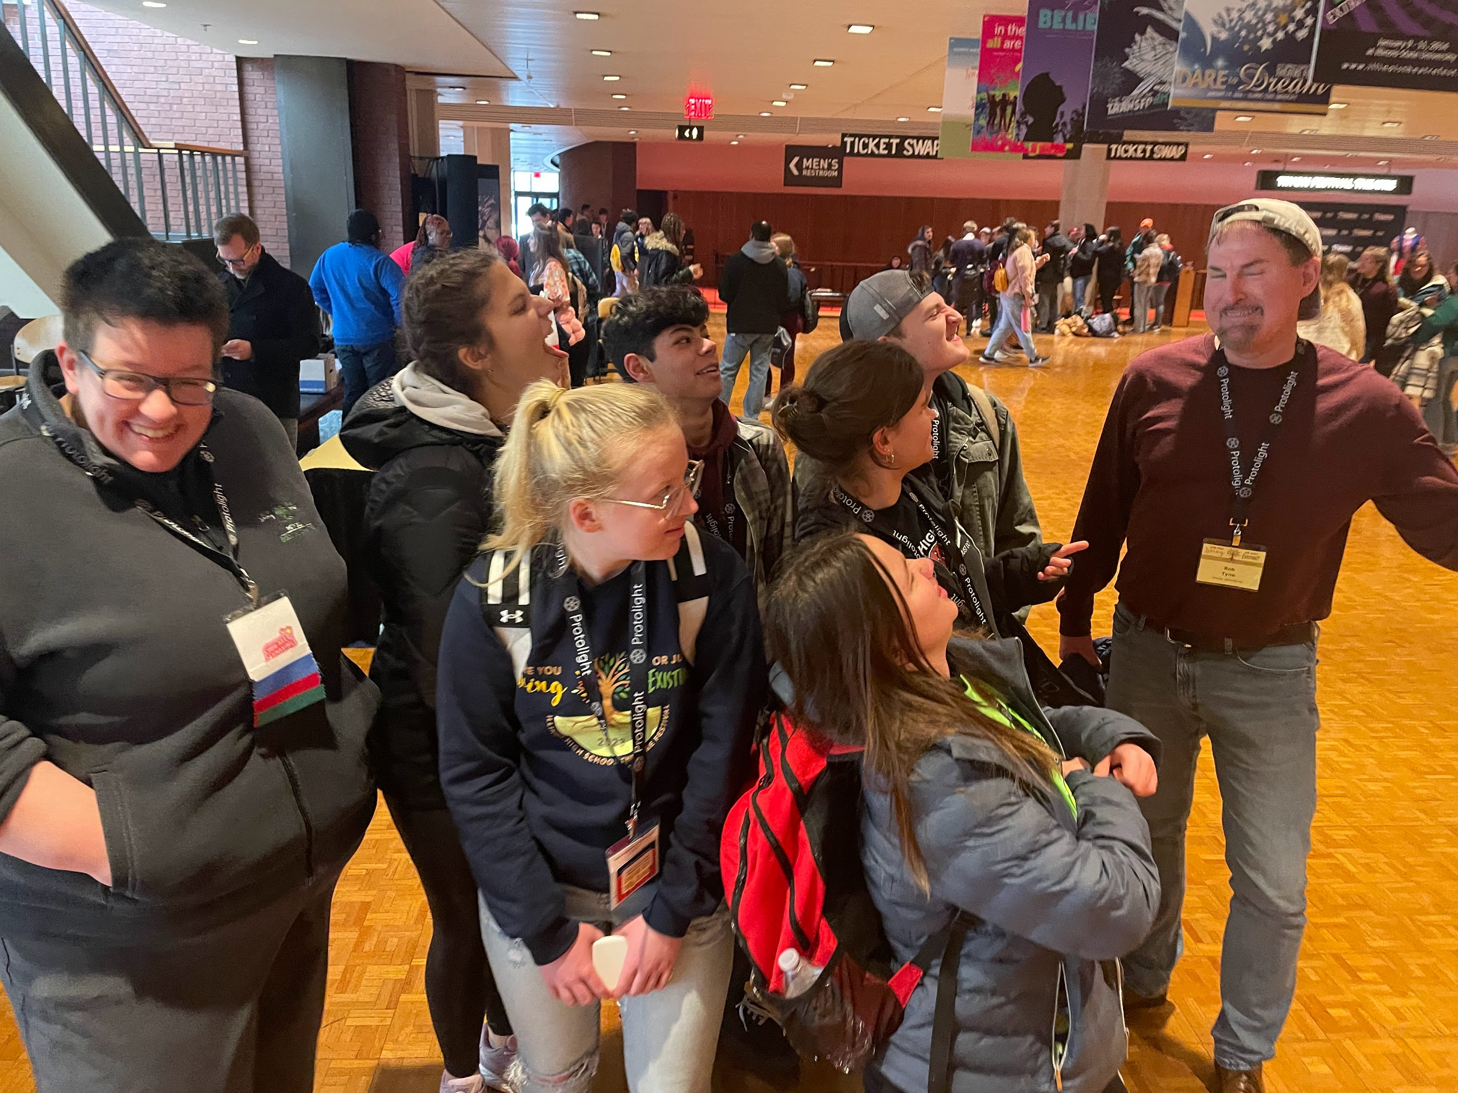

Slide 26
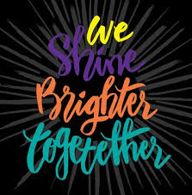
Until next year…..
Next year, we are hoping to raise funds to support our trip (registration fees) by doing a series of fundraisers.
We are re-activating out Thespian Honor Society to make a theatre summer camp for kids from all around streator and neighboring towns.
Next year, the conference is at ISU. We cannot wait to attend and learn even more! As next year’s theme states: “We shine brighter together”

